Slide 1
Intro to Design Patterns
Lecture 2.1 – Facade Pattern

Slide 2
Notes About Code & Presentation
Code Style
Compressed to fit in vertical space
Namespaces
Use to support code folding and group evolution of code
Comparisons
Code presented side-by-side as much as possible
Text and Other Explanations
Typically on slide before code to maximize space for the code itself
Expect 3 namespaces, <dp>_legacy, <dp>_problem, <dp>_solution
Read the comments

Slide 3
Reading
DPE
Chapter 6 – Facade Method
Chapter 8 – Expanding our Horizons (Encapsulating what varies)
Chapter 12 – How do Experts Design?

Slide 4
If the API’s are varying use the Facade pattern
Consider a business with a large, complicated and obtuse enterprise MIS.
Hard to learn.
Hard to use well.
Maintenance headache for IT and programmer staff.
Multiple user groups that only need to use a small part of it…
Sales
RnD
Corp

Slide 5
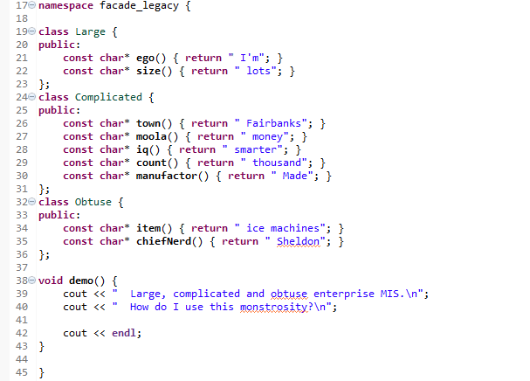
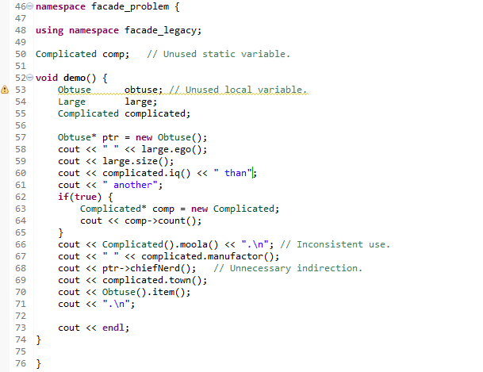


Large, complicated and obtuse interface Users need simpler API’s

Slide 6
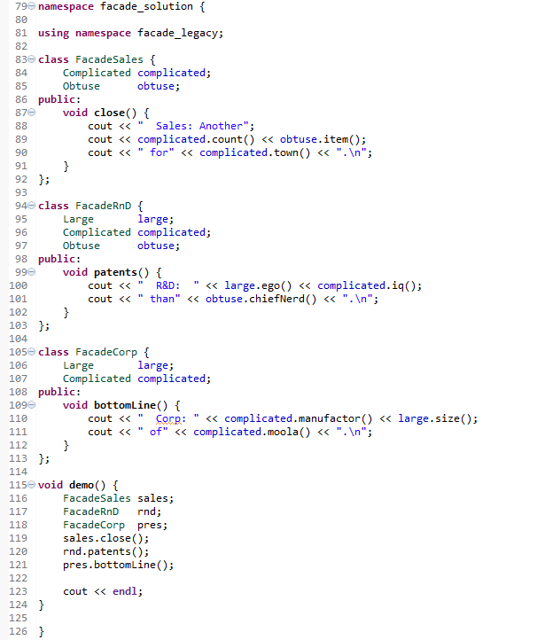


Slide 7
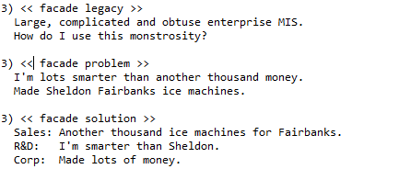
Output

Slide 8
Summary
When the API’s are varying, use the Facade pattern to encapsulate the variations.
Implement a simpler API for each category of user.
Typically the API classes include private objects from the legacy code.
Allows the legacy code to change underneath.
Bug fixes
New features
Refactoring for maintenance
Simplifies users’ life.

Slide 9
Class Progress
If the algorithms are varying
If the interfaces are varying
If the API’s are varying
If the steps are varying
If the classes are varying
If the options are varying
If the listeners are varying
If the responders are varying
If abstract’n & implement’n vary
If the families are varying
Use the Strategy pattern
Use the Adapter pattern
Use the Facade pattern
Use the Template Method pattern
Use the Factory Method pattern
Use the Decorator pattern
Use the Observer pattern
Use Chain of Responsibility pattern
Use the Bridge pattern
Use the Abstract Factory pattern

Slide 10
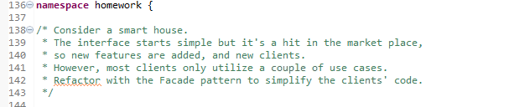
Homework
<Transition to IDE>

Slide 11
Backup Slides

Slide 12
